Slide 1
PACKAGES IN JAVA

Slide 2
PACKAGES
Packages in Java is a mechanism to encapsulate a group of classes, interfaces
and sub packages.
In java there are already many predefined packages that we use while programming.
For example: java.lang, java.io,
java.util
etc.
One of the most useful feature of java is that we can define our own packages

Slide 3
PACKAGES Cont...
Advantages of using a package
Reusability: Reusability of code is one of the most important requirements in the software industry. Reusability saves time, effort and also ensures consistency. A class once developed can be reused by any number of programs wishing to incorporate the class in that particular program.
Easy to locate the files.
In real life situation there may arise scenarios where we need to define files of the same name. This may lead to “name-space collisions”. Packages are a way of avoiding “name-space collisions”.

Slide 4
PACKAGES Cont...
Types of package:
1) User defined package: The package we create is called user-defined
package.
2) Built-in package: The already defined package like java.io.*,
java.lang.* etc are known as built-in packages.

Slide 5
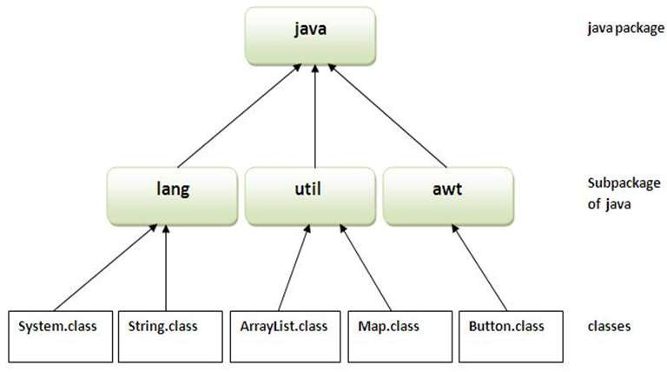

Slide 6
PACKAGES Cont...
Defining a Package:
This statement should be used in the beginning of the program to include that
program in that particular package.
package <package name>;
The package keyword is used to create a package in java.
To Compile: javac -d directory javafilename.java
To Run: java packagename.classname
The -d switch specifies the destination where to put the generated class file

Slide 7
How to access package from another package?
There are two ways to access the package from outside the package.
import package.*;
import package.classname;
Using packagename.*
If you use package.* then all the classes and interfaces of this package will be
accessible but not subpackages.
The import keyword is used to make the classes and interface of another package accessible to the current package.

Slide 8
Using packagename.classname
If you import package.classname then only declared class of this package will be accessible.
Note: If you import a package, all the classes and interface of that package will be imported excluding the classes and interfaces of the subpackages. Hence, you need to import the subpackage as well.

Slide 9
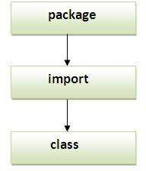
Sequence of the program must be package then import then class.

Slide 10
//save as Simple.java package mypack; public class Simple{
public static void main(String args[]){ System.out.println("Welcome to package");
}
}
To Compile:
e:\sources> javac -d c:\classes Simple.java
To Run:
To run this program from e:\source directory, you need to set classpath of the directory where the class file resides.
e:\sources> java mypack.Simple

Slide 11
//save by A.java
package mypack1;
public class A{
public void msg()
{
System.out.println("Hello");
}
}
//save by B.java
package mypack2;
import mypack1.*;
class B{
public static void main(String args[]){
A obj = new A();
obj.msg();
}
}

Slide 12
THANK YOU

